Slide 1
BAZAAR #2
By The 4 Codesmen - Abraham, Dhruv, Dinesh, Favor
ENSE 400/477(2022-2023): SSE Capstone

Slide 2
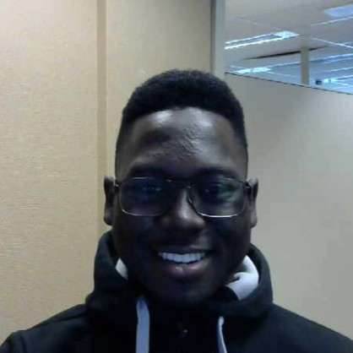
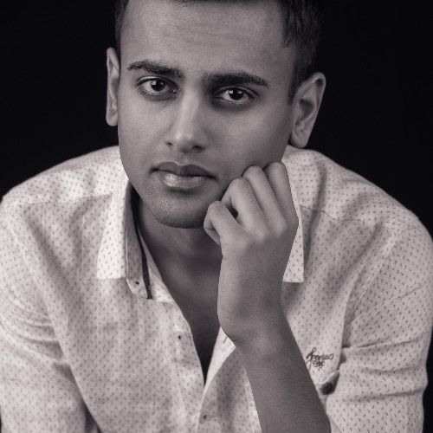
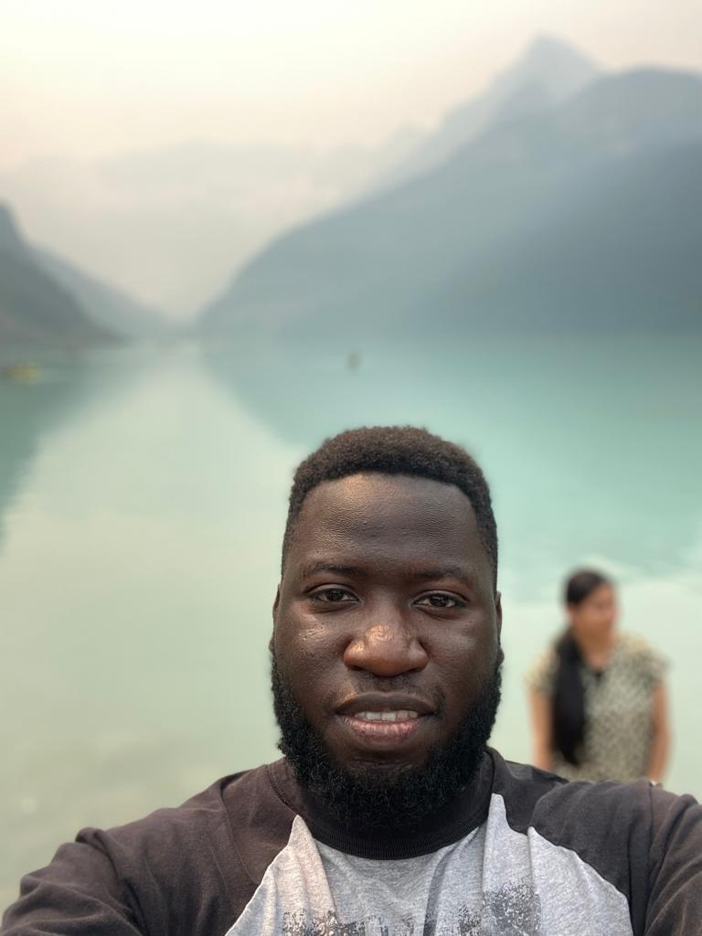
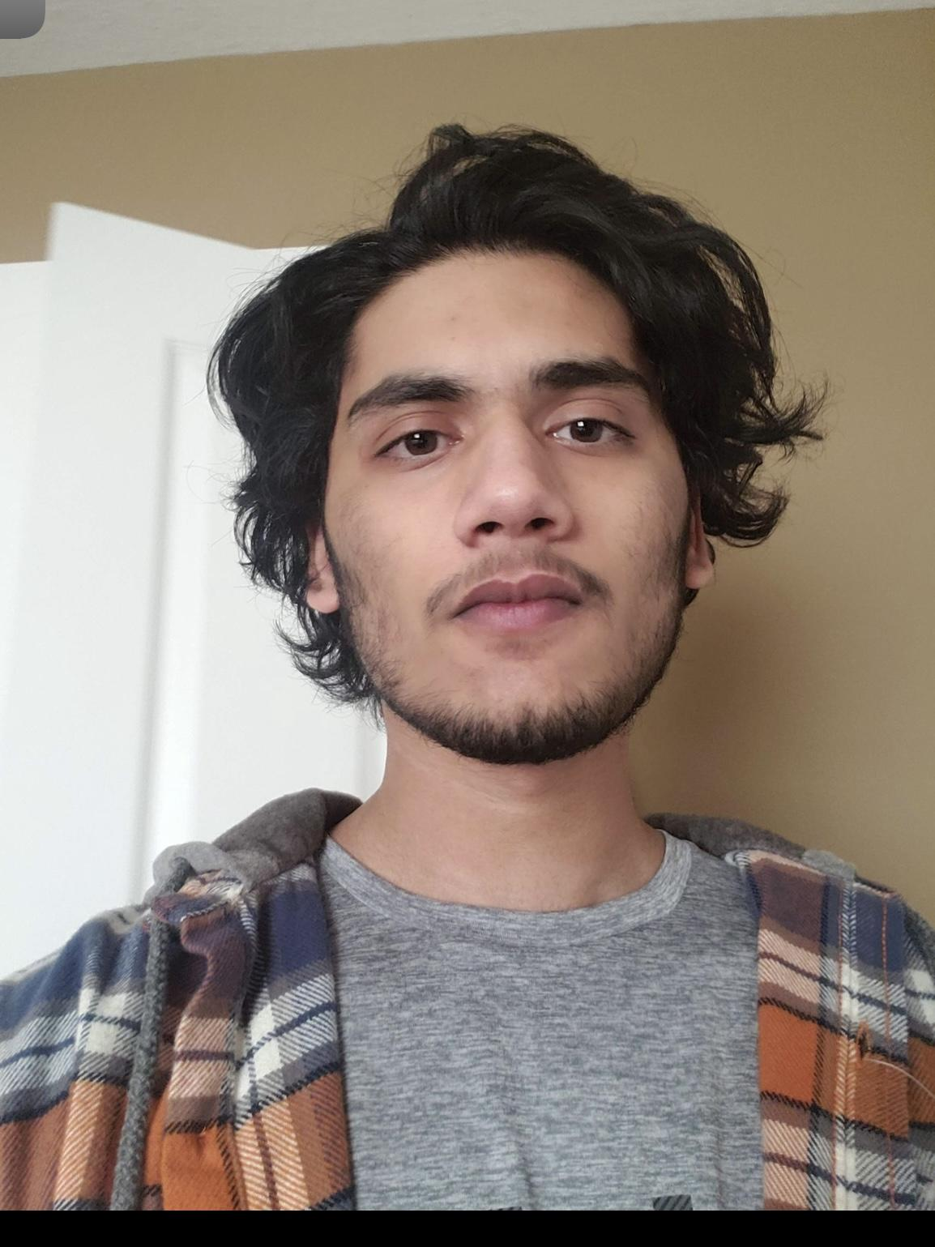
Team Members
Favor Fasunwon Front-End Developer and UI/UX Designer
Dhruv Modi Team Lead and Backend Developer
Abraham Mugerwa Front-End Developer and Documentation Manager
Dinesh Dalip Software Architect and Backend Developer

Slide 3
Project background & business need/opportunity
For our capstone project we are building a web application for U of R residence that allows U of R Residence Students:
To connect with each other
Make friends
Help each other out academically [Build a community]
Be part of the Residence life [Stay updated about events]
To decrease/eliminate the social gap [Less isolation and increased socialization]
Current Situation?
Opportunity?
Notes:
Current Situation
Currently U of R Residence does not have a dynamic application that brings U of R Students together. There is an application for U of R Residence however it is outdated and requires a major upgrade.
Opportunity
Build an application for U of R residence that
Replaces the old application
Enhances the experience of living on campus
Go beyond U of R and share this digital ecosystem with other University Residences as well.

Slide 4
Previous Status Description
Scrum #1 - Oct 4 2022
Status - Green
Dhruv: Business Case and Roles/Responsibilities Document, Vlog Presentation/Script, Vlog#1 Video Editing, and Technology Stack research
Abraham: Project charter and Meeting Minutes Documentation, Vlog Presentation/Script, and Updating our Github and Wiki Page.
Dinesh: Project Scope Statement Documentation, Vlog Presentation/Script, Technology Stack research.
Favor: RACI Chart and Project Requirement Documentation, Vlog Presentation/Script, Technology Stack research
Tim's notes: Good idea to touch base with the Residence folks to compare the current application.

Slide 5
Scrum #2 - Oct 18 2022
Status - Green
Team: We worked on the final lofi diagram, the scrum 2 presentation, and meeting with Bryan (Manager of UR residence) as per Tim’s feedback.
Dhruv: Lo-Fi prototype, Set up meeting with Craig Oct 20 @12pm, Use Case Diagram,Scrum 2 Powerpoint
Abraham: Lo-Fi prototype, Hi-Fi prototype with Favor
Dinesh: Lo-Fi prototype, Use Case Diagram, Class Diagram for main features, layout of the database schema, Found APIs, User Story Map with Favor refreshed knowledge about MERN stack.
Favor: Emailed Bryan regarding our application and a potential comparison of our app and theirs. Lo-Fi prototype. Hi-Fi prototype with Abraham as well as testing it with a previous residence attendee (User Testing). Studied React and Node Js via youtube tutorials and courses. Implemented the login functionality for code base setup (front and back end). User Story Maps with Dinesh.
Tim's notes: It might be interesting to see who contributed recipes/events, etc.

Slide 6
Scrum #3 - Nov 29 2022
Status - Green
Team: As per Tim’s feedback we decided to make the application render random recipes as opposed to each student posting their recipe. Then we had a meeting with Craig (Mentor), assigned different features to each members via sub groups (2 sub groups - Dhruv and Abraham (Food Feature), Favor and Dinesh (chat system)), merged completed code for Food Feature and Chat Feature
Dhruv: Took the lead on creating the Takeouts Page with Favor on call for assistance. Emailed Craig for meeting, I and Favour refactored/restructured the Takeouts Page code .
Abraham: Took the lead on creating the recipe page with Dinesh on call for assistance, completed Meeting minutes. Worked with Favor to refactor styling of entire App to look more presentable and fit the aspired theme
Dinesh: Worked with Favor on Chat System, helped Abraham with Recipe feature, and Created Gantt chart.
Favor: Worked with Dinesh on Chat System. Implemented delete user functionality. Worked with Abraham to refactor styling of entire App to look more presentable and fit the aspired theme.

Slide 7
Current Status Description
Green
We believe we are still in the Green zone as we are now 3 out of 4 on the total anticipated features we planned. More importantly we were able to appropriately utilize the MVC, and observer design pattern in particular features of the application.
Team: Worked powerpoint, merged update codebase, and discussed separation of workload for the next 2 weeks. Worked on Project Day Information Page.
Dhruv: Took lead on Dashboard feature with Favor on call for assistance. Researched PWA (Progressive Web App) for a potential conversion of our application.
Abraham: Updated documents on Github and Wiki.
Dinesh: Took lead on events page.
Favor: Assisted Dhruv with Dashboard feature. Research Mern stack deployment on Heroku

Slide 8
Project Changes/Issues
Issues
API calls (limited API calls)
Notification functionality not full working on chat system.
Issues with Date format of backend database and react- Calendar library on Event Page. - sorted
Scope creep. New ideas keep forming by team members to implement which might not reflect our original purpose of the application.

Slide 9
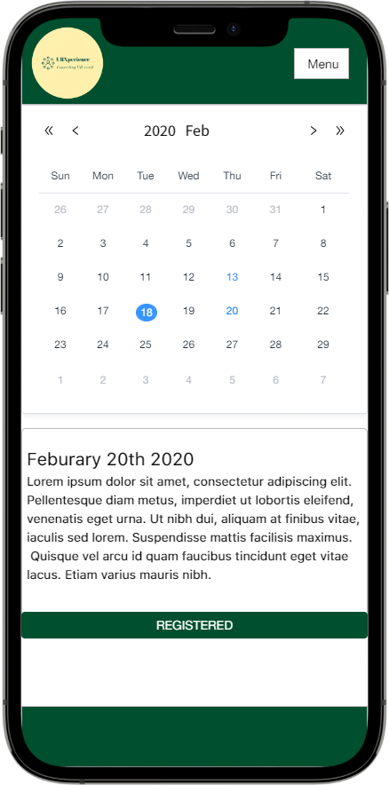
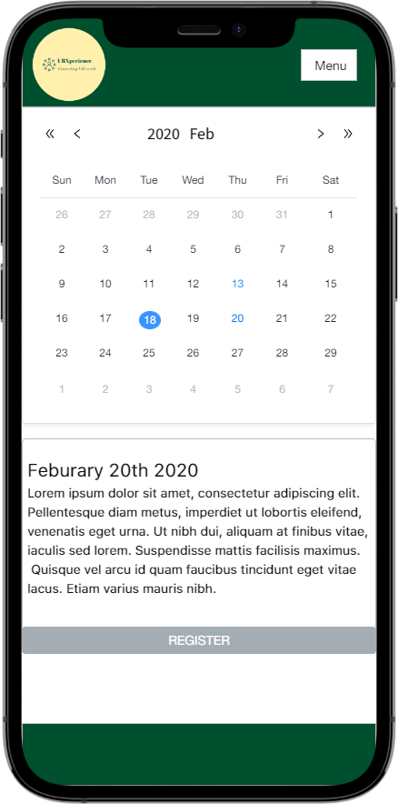
Events Page(In progress)

Slide 10
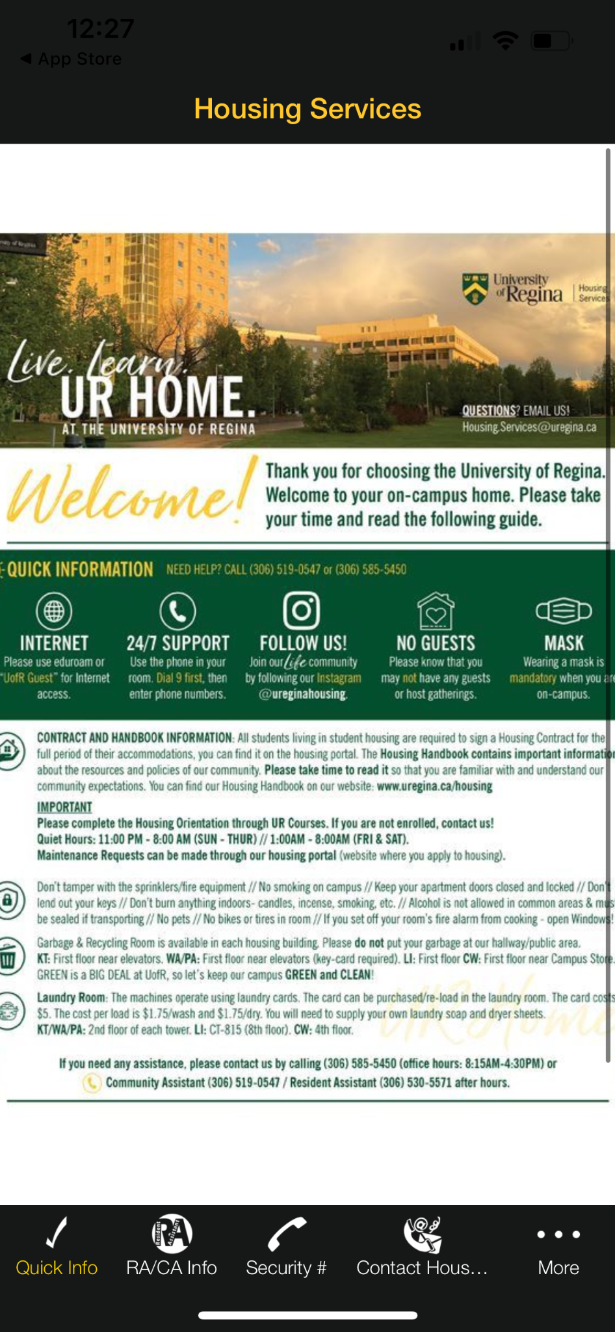
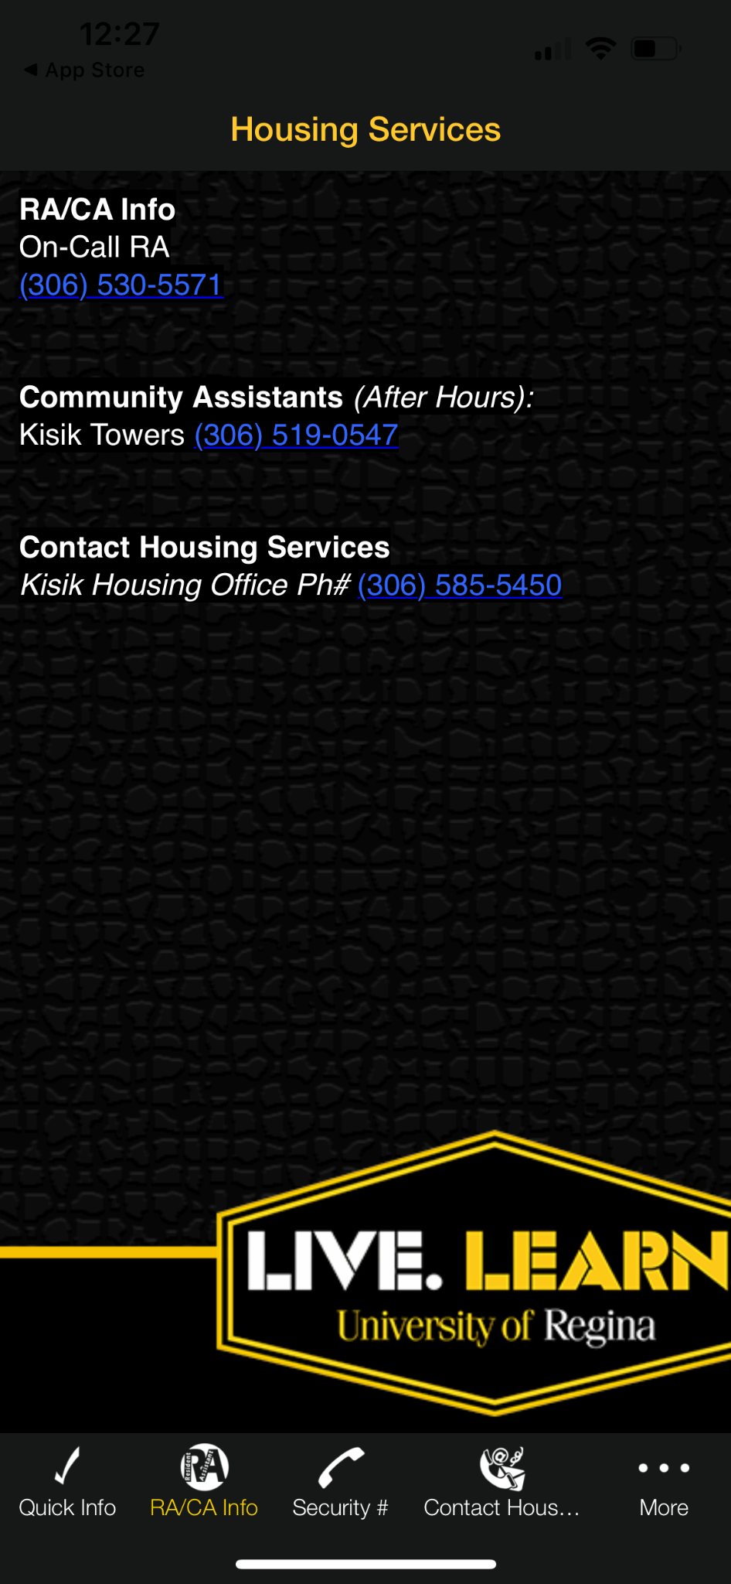
Current Application

Slide 11
PROJECT DEMO

Slide 12
Next Up
Team: Project day preparation. Code and user Testing
Dhruv: Continue Dashboard feature with Favor for assistance
Dinesh: Finish Event Page with MVP2 functionalities. Add functionalities to the Chat System (ability for users to create group chats, add notification system, and improve UI)
Favor: Implement faculty/residence resource page with Dhruv for assistance
Abraham: Work on MVP 2 of the Recipe page with Dinesh on call for assistance.

Slide 13
Team Reflection
Does the team feel "on track"? (reiterate the above colour status)
Green Status. Group member’s dedication over the break kept us on track of our goals. As per our gantt chart we are still on track.
What progress does the team particularly feel good (great) about?
We did a lot of heavy lifting in our first half of the semester for this course, leaving us some room for testing and extra features once we finish our last MVP.
What barriers (if any) does the team feel are a current impediment to success?
Future cost for API and potential scope creep.
What help (if any) does the team require to move positively forward?
None at this current time, but we will reach out if issues arise.
What questions or concerns does the team have (if any)?
None at this current time. We await important wiki feedback on our application

Slide 14
Thanks!
Do you have any questions?
fourcodesmen@gmail.com
Please keep this slide for attribution

